Slide 1
Dealing with Multiple Phenotypes in Association Study
Lei Chen
Dec. 8, 2016

Slide 2
Question came from my own research…
Copy number variation (CNV) association study in Finnish population
2048 people’s Whole Genome Sequencing data
~6000 CNVs called by GenomeSTRiP
136 quantitative traits

Slide 3
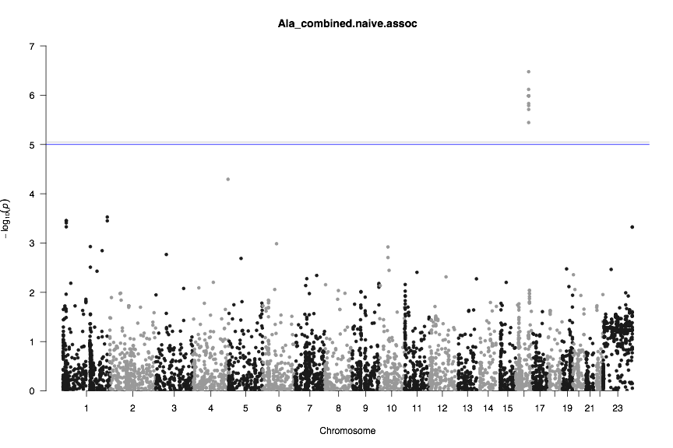
Stage 2 with old phenotype data
Allele frequency 0:1:2:3= 0.0005:0.0229:0.9634:0.0132 (stage 2)

Slide 4
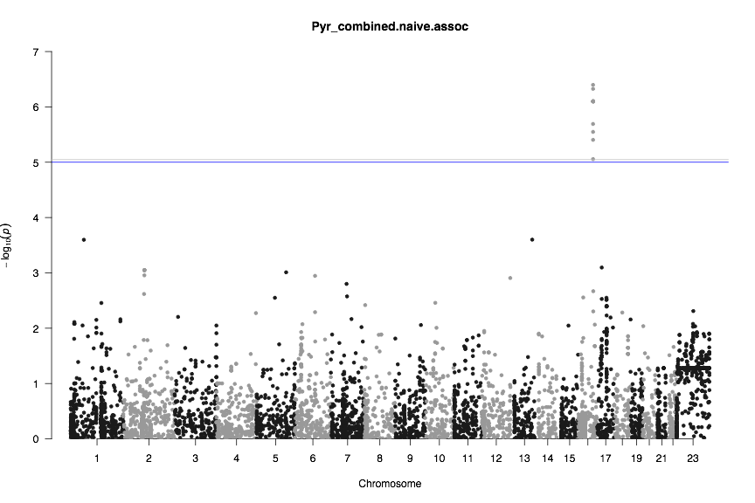
In stage 2: Same variants associated with Pyruvate

Slide 5
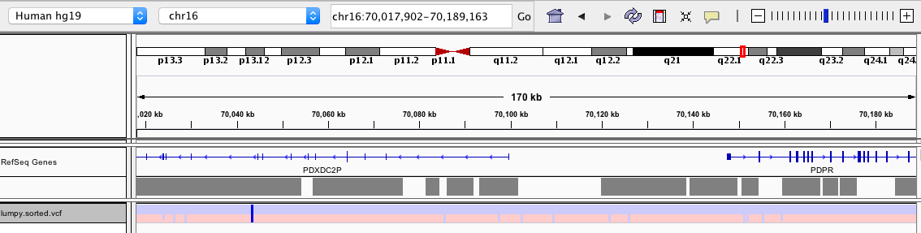
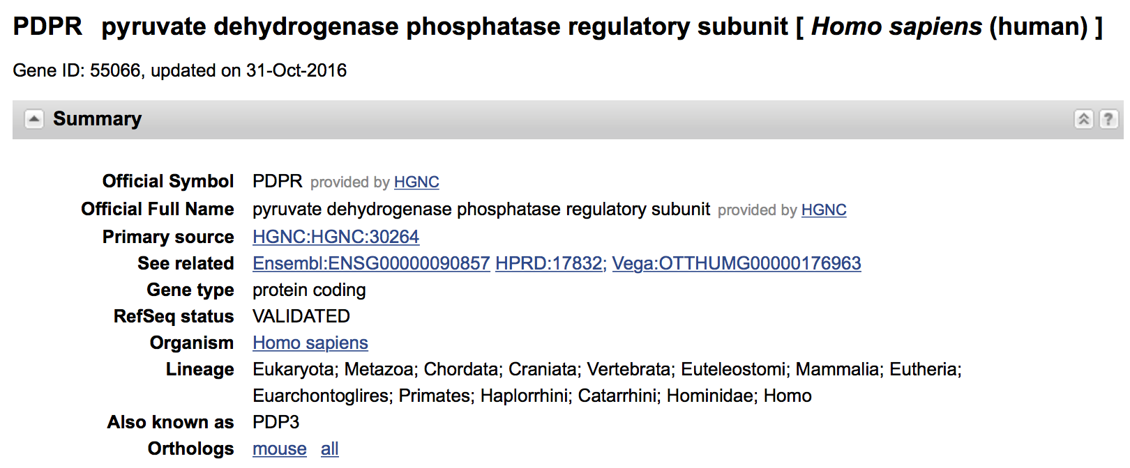
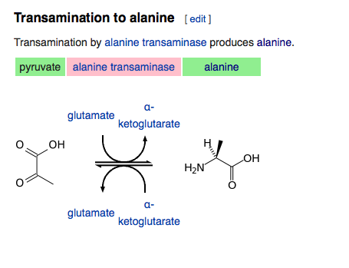

Slide 6
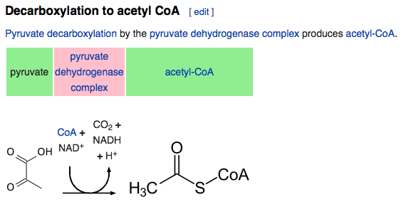


Possible mechanism
increase
-
-
-
-
+
PDPR
(pyruvate dehydrogenase phosphatase regulator)
-
pyruvate dehydrogenase phosphatase
Chr16 DUP
Notes:
The amount of pyruvate decreases -> substrates of transamination decreases -> alanine decreases
Alanine might be secondary signal. Pyruvate should be more sensitive then, (but why Pyr was not significant in the first stage?)

Slide 7
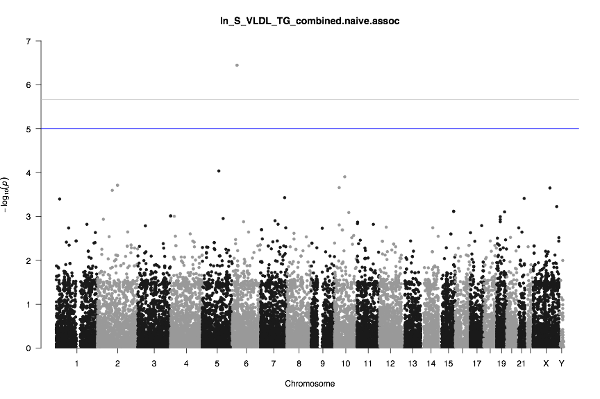
Other recurrent signals in (correlated?) phenotypes

Slide 8
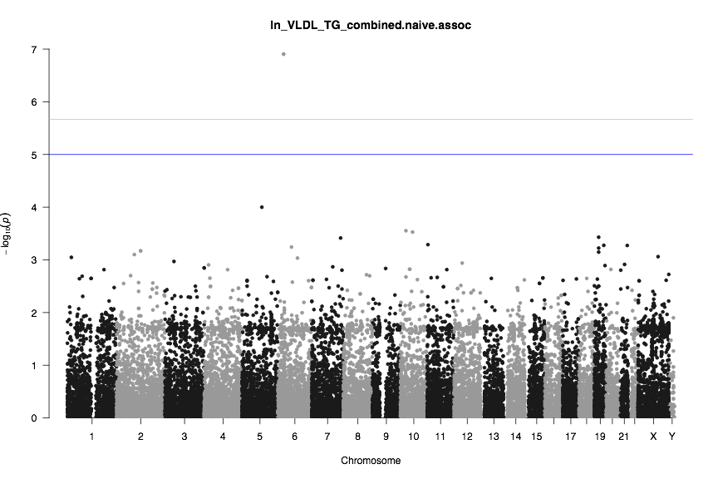
Other recurrent signals in (correlated?) phenotypes

Slide 9
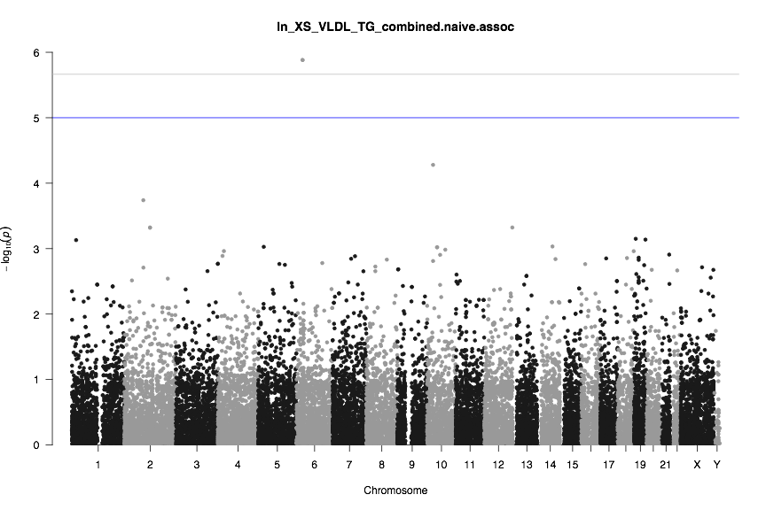
Other recurrent signals in (correlated?) phenotypes

Slide 10
“Bitter and sweet” in dealing with multiple traits
Benefits
Gain confidence about recurrent findings
Identify pleiotropic effects
Challenges
Multi-testing correction
Unknown underlying correlation between traits

Slide 11
Possible Solutions
“Collapsing” of correlated phenotypes
Adjusting error controlling
PheWAS — a converse approach for association study

Slide 12
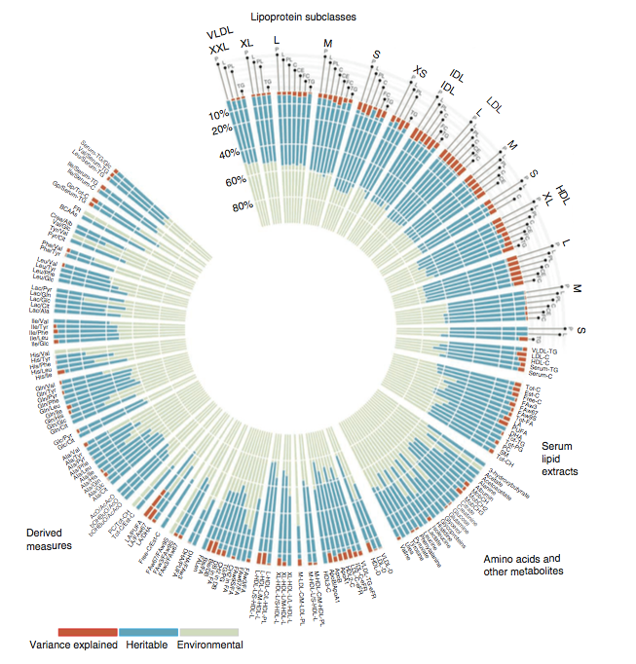
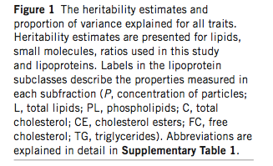
Example -“Collapsing” of Correlated Traits
Kettunen et. al, 2012

Slide 13
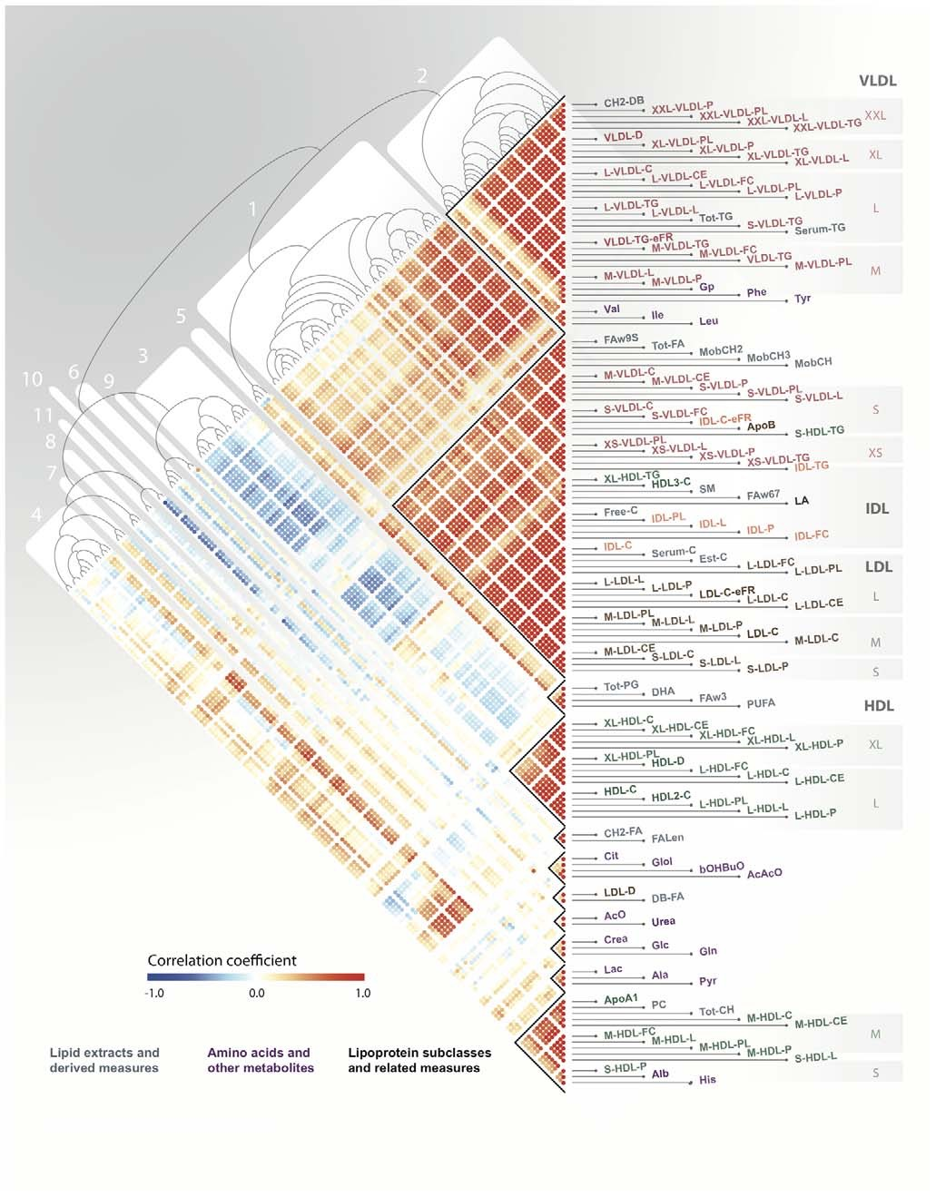
Hierarchical clustering using Pearson correlation matrix.
The resulting heatmap and dendrogram are presented at left.
Inouye et. al, 2012
Notes:
red indicating high positive correlation, blue high negative correlation, and white no correlation. Clusters of tightly correlated metabolites, metabolic networks, are labeled 1–11

Slide 14
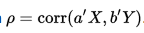
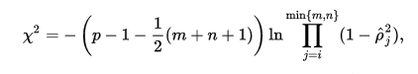
Statistics for multivariate collapsing traits association
Intuition:the relationships among the endogenous variables must be taken into account in addition to those between the endogenous and exogenous variables.
Canonical Correlation Analysis:
Seeks for vector a and b which let a’X and b’Y maximize the correlation
Hypothesis testing:
Notes:
Given these two sets of variables, the aim is to simultaneously find the best predictor of the linear functions of one set as well as the linear function of the other set it best predicts. This yields a pair of variates which are referred to as the first pair of canonical variates. Using the residuals of these linear functions, the process can be repeated to obtain the second pair of canonical variates, and so on. The full sequence of these pairs of variates and their correlations then fully describe the invariant relationships between the endogenous variable set and the exogenous variable set

Slide 15
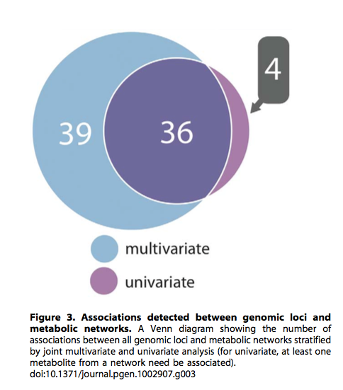
Multivariate test increased the power of detecting

Slide 16
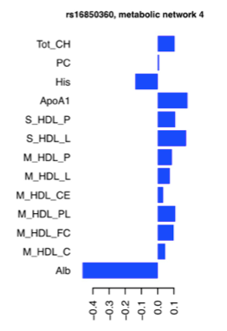
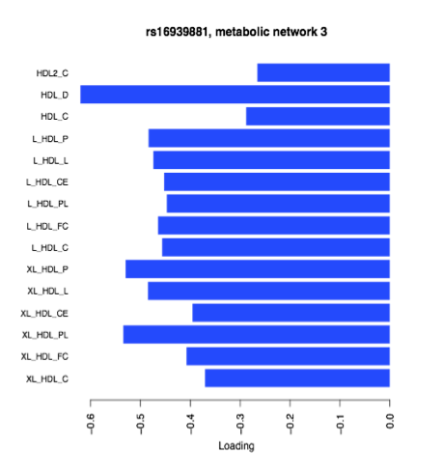
Effects can be in same/different directions for traits

Slide 17
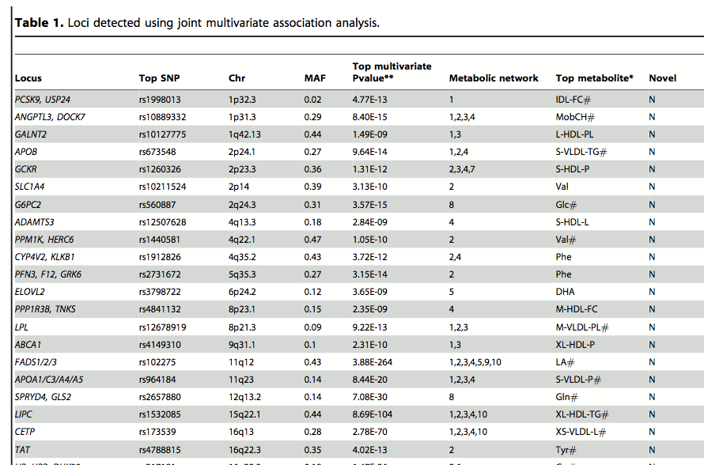
Limitation: Can’t get P-value for single traits

Slide 18
Adjusting error controlling

Slide 19
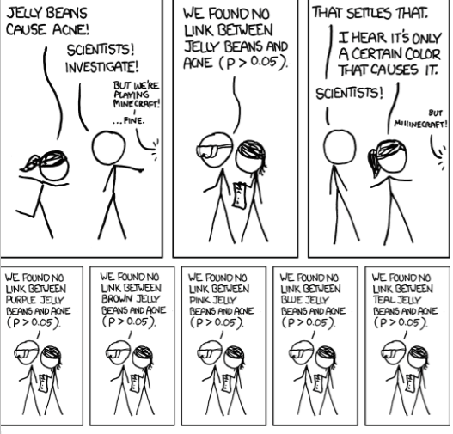
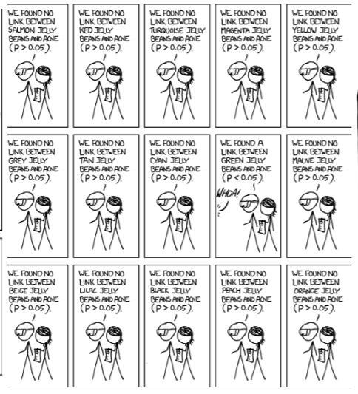
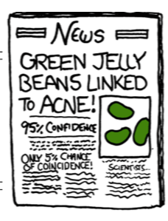
“The Curse of Multiple Testing”

Slide 20
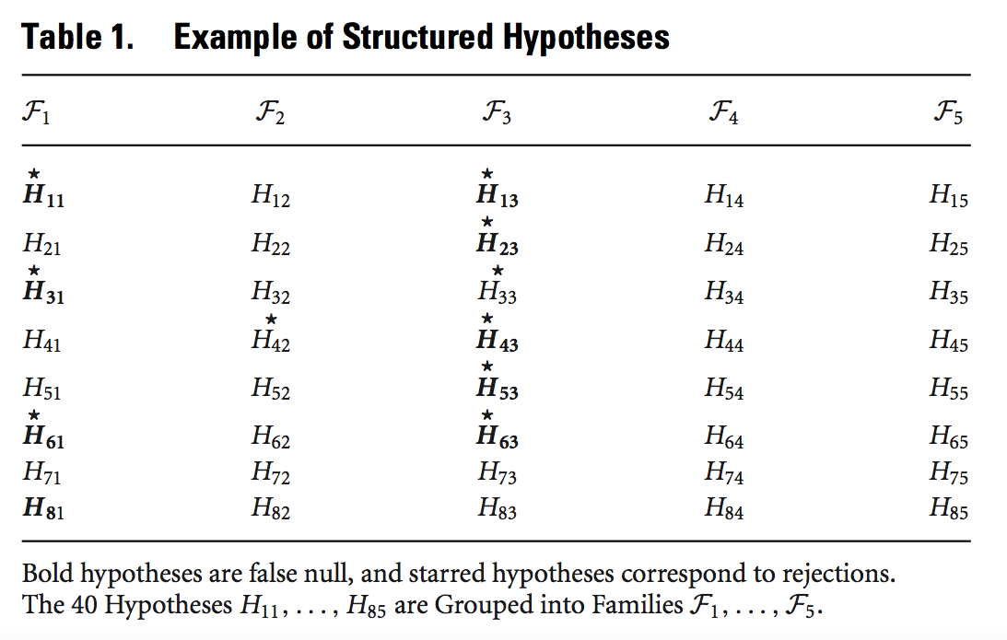

Hypotheses of Multi-traits Testing are Structured
Traits
Variants
Peterson et al, 2015

Slide 21
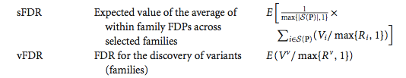
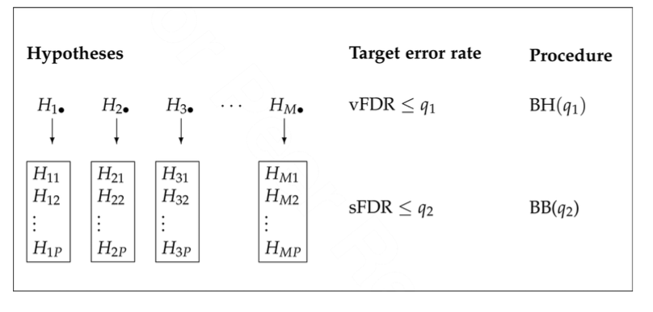
A Hierarchical Testing Stratege
Peterson et al, 2015

Slide 22
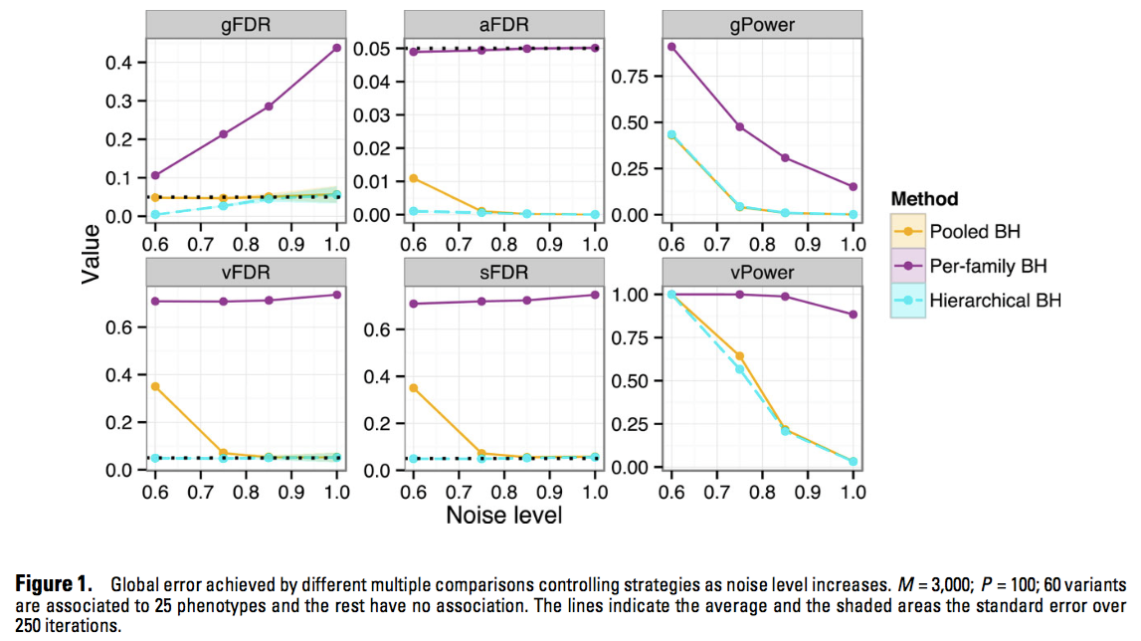
Hierarchical Method Lower the False Discovery Rate
(While more sensitive to noise?)
Peterson et al, 2015

Slide 23
Basic Idea of PheWAS
(Phenome-wide Association Studies)
GWAS
PheWAS
Genotype
X
Phenotype
Phenotype
Y
Genotype

Slide 24
PheWAS — a converse approach for association study
Intuition
Correlation — statistically symmetric property
Pleiotropic effects — increasing the power of detection
What makes PheWAS possible?
“Phenome” data — available standardized and large traits data
Pre-knowledge of variants selection

Slide 25
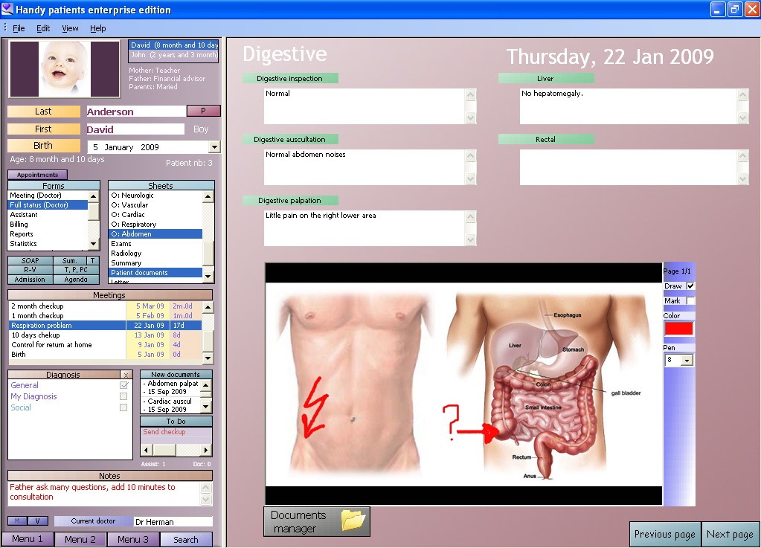
“Phenome": Electronic Medical/Health Records (EMRs/EHRs)
image: wikipedia
Notes:
longitudinal records; diverse data sources ;ICD9 coding system contains over 14 000 disease codes grouped into a multi-level hierarchy of codes.
An electronic health record (EHR), or electronic medical record (EMR), refers to the systematized collection of patient and population electronically-stored health information in a digital format.[1] These records can be shared across different health care settings. Records are shared through network-connected, enterprise-wide information systems or other information networks and exchanges. EHRs may include a range of data, including demographics, medical history, medication and allergies, immunization status, laboratory test results, radiology images, vital signs, personal statistics like age and weight, and billing information.[2]

Slide 26
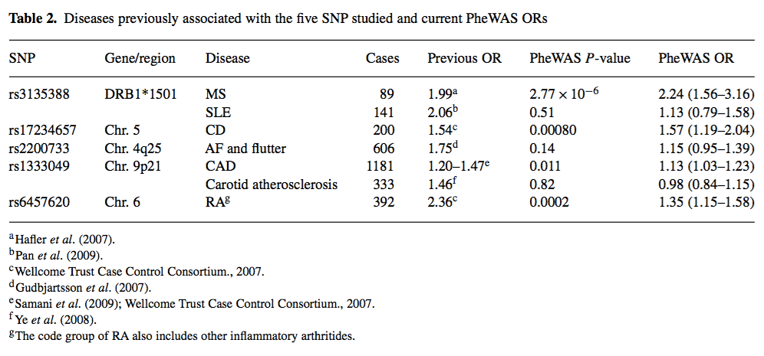
First attempt of PheWAS:proof-of-principle study
Small sample size (most common: 2877 patients for hypertension); Only 5 pre-identified associated SNPs; but still succeeded in replicating the association.
Denny et al, 2010

Slide 27
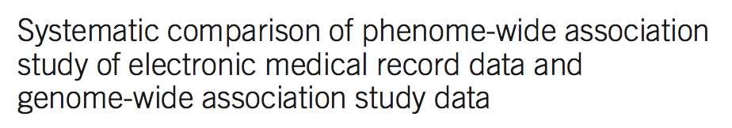
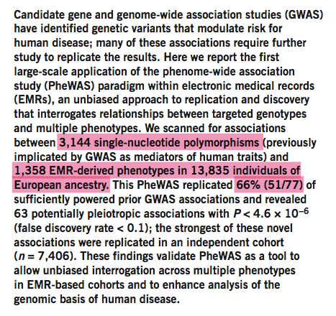
Similar approach was done in much larger cohorts.
Denny et al, 2014

Slide 28
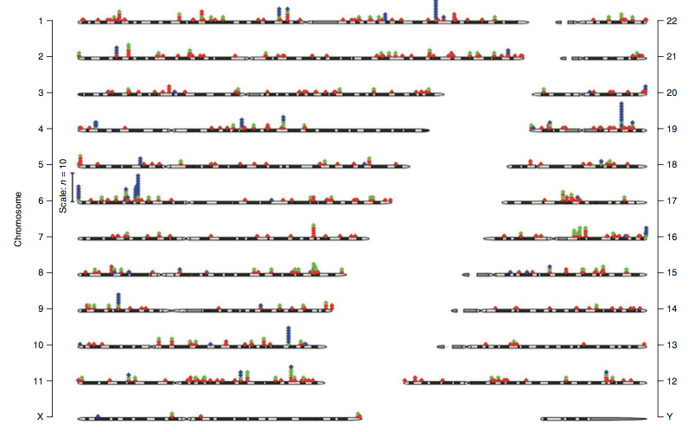

NHGRI GWAS findings only
GWAS & PheWAS
PheWAS only
Notes:
Red diamonds represent associations in the NHGRI Catalog only (including phenotypes not present in the PheWAS catalog), green diamonds represent NHGRI Catalog associations replicated by PheWAS (P < 0.05), and blue diamonds represent new phenotype associations identified by PheWAS (P < 4.6 × 10−6, or a FDR < 0.1). Numbers to the right and left indicate chromosomes.

Slide 29
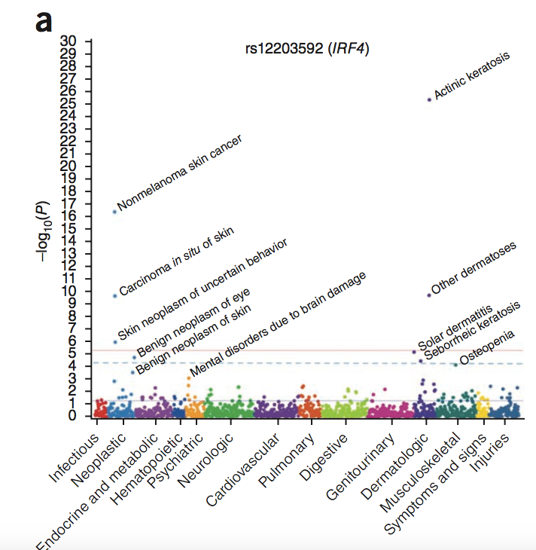
Pleiotropic effects were identified by this approach

Slide 30
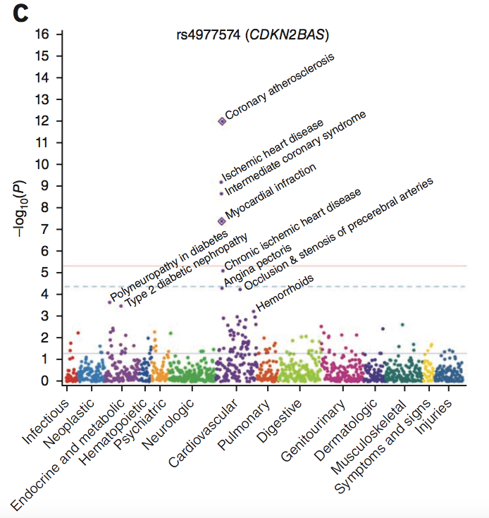
Pleiotropic effects were identified by this approach

Slide 31
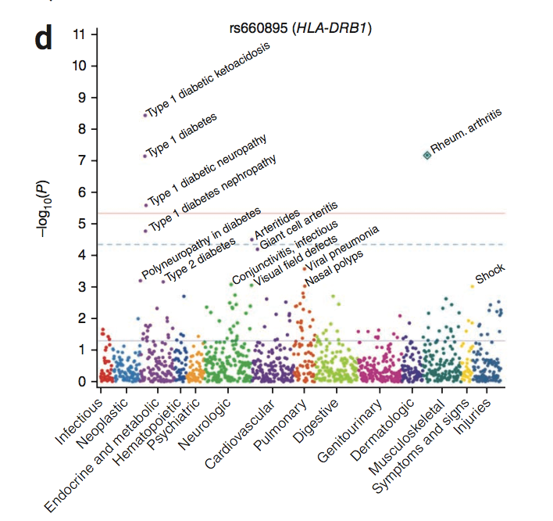
Pleiotropic effects were identified by this approach

Slide 32
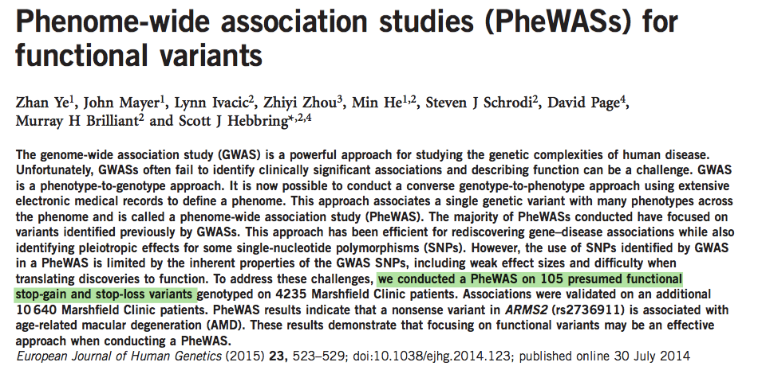
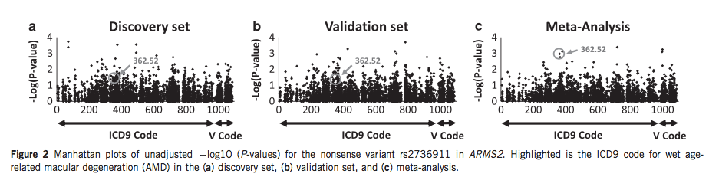
Variants Selection: From Known to Unknown

Slide 33
PheWAS Summary
Advantages:
Good use of comprehensive traits information
Traits can be related or unrelated (no assumption)
Avoiding heavy penalty from multiple testing
Relatively easy to interpret (as compensation to GWAS)
Limitation:
Variants selection
Weak tool for discovery
Charges for using pre-knowledge?

Slide 34
Summarize the Methods for Multiple Trait Association
 | Advantages | Limitations
Collapsing Phenotype | Increases power by decreasing number of tests; | Only benefit from correlated traits; difficulty in controlling clustering quality; lack of error control for single trait
Adjusting Error Control | Good balance between keeping the power and decreasing false discovery rate; | Sensitive to noise; requires structured hypotheses groups;
PheWAS | No requirement for phenotype data; small test number; identify shared effects | Limited variants are tested; escapes from the penalty of pre-knowledge;

Slide 35
Acknowledgement
HLA course team
Dr. John Rice
Hall Lab
Dr. Ira M. Hall
Dr. Haley J. Abel
McDonnell Genome Institute (many people)
FinMetSeq Consortium
Other resources
Dr. Timothy Thornton (visiting professor, University of Washington)

Slide 36
Supplementary Slides

Slide 37
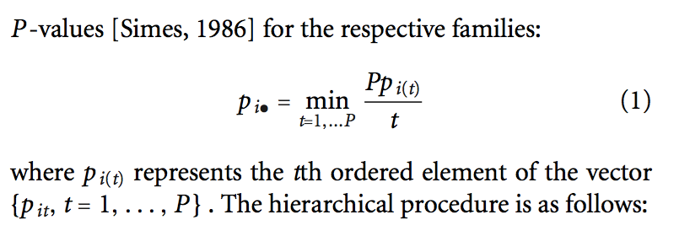
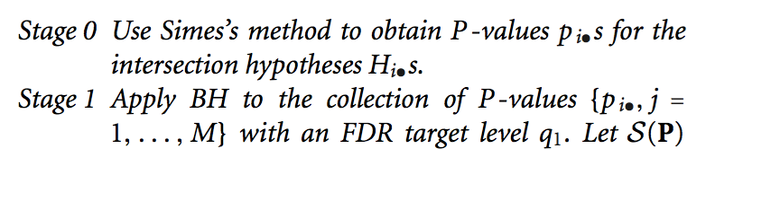
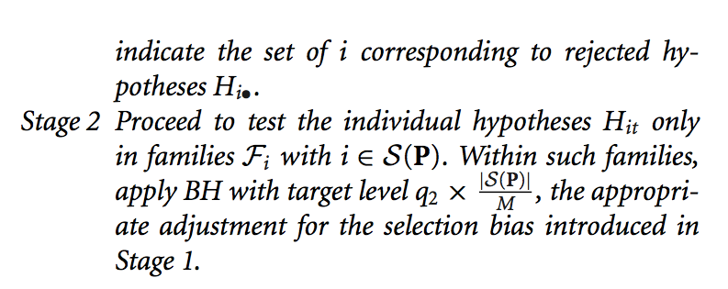

Slide 38
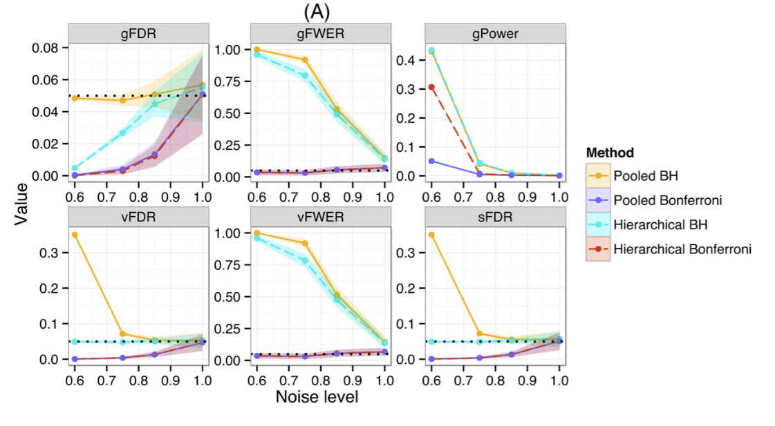
More Simulation Tests in Peterson’s Paper

Slide 39
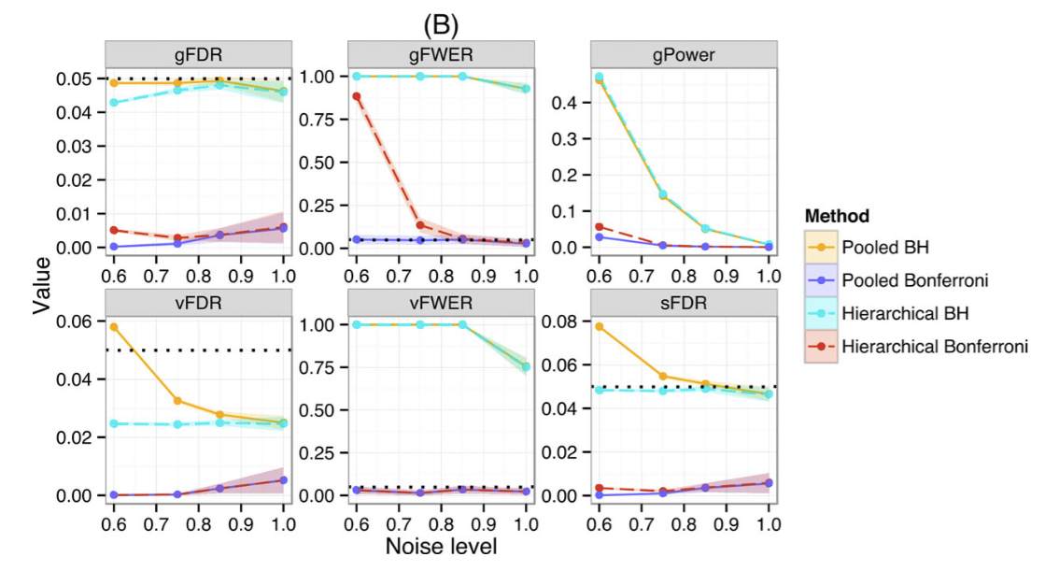
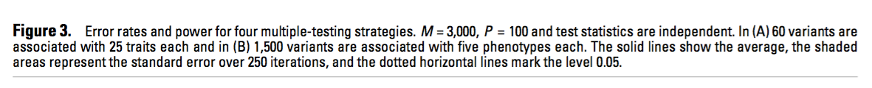

Slide 40
